Slide 1
Array
Presented By S.R.Zameer

Slide 2
What is an Array?
An array is a variable which can store multiple values of same data type at a time.
"Collection of similar data items stored in continuous memory locations with single name".

Slide 3
Array Declaration
int a[3];
Here, the compiler allocates total 6 bytes of continuous memory locations with single name 'a'. But allows to store three different integer values (each in 2 bytes of memory) at a time. And memory is organized as follows...

Slide 4

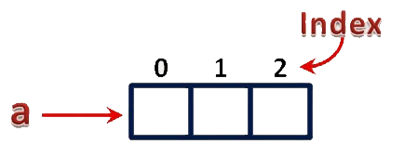
Process in RAM

Slide 5
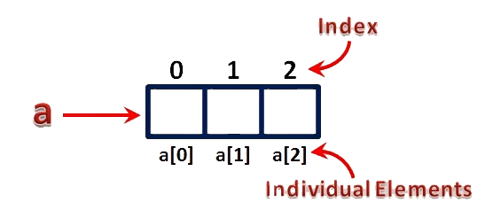
Individual Elements
arrayName[indexValue]

Slide 6
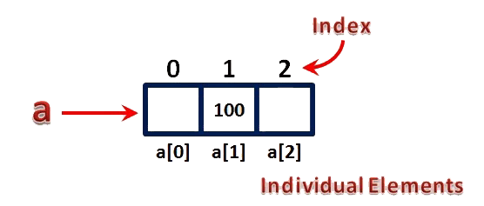
Assign a value to an array
a[1] = 100;

Slide 7
Types of Arrays in C
In c programming language, arrays are classified into two types. They are as follows...
Single Dimensional Array / One Dimensional Array
Multi Dimensional Array

Slide 8
Single Dimensional Array
In c programming language, single dimensional arrays are used to store list of values of same datatype. In other words, single dimensional arrays are used to store a row of values. In single dimensional array, data is stored in linear form. Single dimensional arrays are also called as one-dimensional arrays, Linear Arrays or simply 1-D Arrays.

Slide 9
Declaration of Single Dimensional Array
We use the following general syntax for declaring a single dimensional array...
datatype arrayName [ size ] ;
Example
int rollNumbers [60] ;

Slide 10
Initialization of Single Dimensional Array
We use the following general syntax for declaring and initializing a single dimensional array with size and initial values.
datatype arrayName [ size ] = {value1, value2, ...} ;
Example
int marks [6] = { 89, 90, 76, 78, 98, 86 } ;

Slide 11
Another Way
We can also use the following general syntax to intialize a single dimensional array without specifying size and with initial values...
datatype arrayName [ ] = {value1, value2, ...} ;
Example
int marks [] = { 89, 90, 76, 78, 98, 86 };
char studentName [] = “zameer" ;

Slide 12
Accessing Elements of Single Dimensional Array
We use the following general syntax to access individual elements of single dimensional array...
arrayName [ indexValue ];
Example
marks [2] = 99 ;

Slide 13
Multi Dimensional Array
An array of arrays is called as multi dimensional array. In simple words, an array created with more than one dimension (size) is called as multi dimensional array. Multi dimensional array can be of two dimensional array or three dimensional array or four dimensional array or more... Most popular and commonly used multi dimensional array is two dimensional array. The 2-D arrays are used to store data in the form of table. We also use 2-D arrays to create mathematical matrices.

Slide 14
Declaration of Two Dimensional Array
datatype arrayName [ rowSize ] [ columnSize ] ;
Example
int matrix_A [2][3] ;
The above declaration of two dimensional array reserves 6 continuous memory locations of 2 bytes each in the form of 2 rows and 3 columns.

Slide 15
Initialization of Two Dimensional Array
datatype arrayName [rows][colmns] = {{r1c1value, r1c2value, ...},{r2c1, r2c2,...}...} ;
Example
int matrix_A [2][3] = { {1, 2, 3},{4, 5, 6} } ;

Slide 16
Accessing Individual Elements of Two Dimensional Array
arrayName [ rowIndex ] [ columnIndex ];
Example
matrix_A [0][1] = 10 ;

Slide 17
Applications of Arrays
Arrays are used to Store List of values
Arrays are used to Perform Matrix Operations
Arrays are used to implement Search Algorithms
Arrays are used to implement Sorting Algorithms
Arrays are used to implement Datastructures

Slide 18
Arrays are used to Store List of values
single dimensional arrays are used to store list of values of same datatype. In other words, single dimensional arrays are used to store a row of values. In single dimensional array data is stored in linear form.

Slide 19
Arrays are used to Perform Matrix Operations
We use two dimensional arrays to create matrix. We can perform various operations on matrices using two dimensional arrays.

Slide 20
Arrays are used to implement Search Algorithms
We use single dimensional arrays to implement search algorithms like ...
Linear Search
Binary Search

Slide 21
Arrays are used to implement Sorting Algorithms
We use single dimensional arrays to implement sorting algorihtms like ...
Insertion Sort
Bubble Sort
Selection Sort
Quick Sort
Merge Sort, etc.,

Slide 22
Arrays are used to implement Data structures
We use single dimensional arrays to implement datastructures like...
Stack Using Arrays
Queue Using Arrays

